Slide 1
JIRA with PLM
Dream it Plan it Do it
Klus • LinkTech Inc • 2019研討會

Slide 2
Project Lifecycle
PLM With JIRA
WBS Gantt Chart

Slide 3
Project Lifecycle Management

Slide 4
4 Phases of the PLM

Slide 5
Native JIRA Focus On

Slide 6
PLM With JIRA

Slide 7
PLM JIRA Focus On

Slide 8
PLM JIRA Core Structure
Tracking Project Detail
Tracking Issue Detail

Slide 9
Project Overview

Slide 10
Project Detail
Project Leader
Watcher
Project 效益
Project 產出
Warning Alert
(專案細節皆可使用JIRA原生功能進行客製)

Slide 11
PLM 專案流程
彈性客製化的專案流程

Slide 12
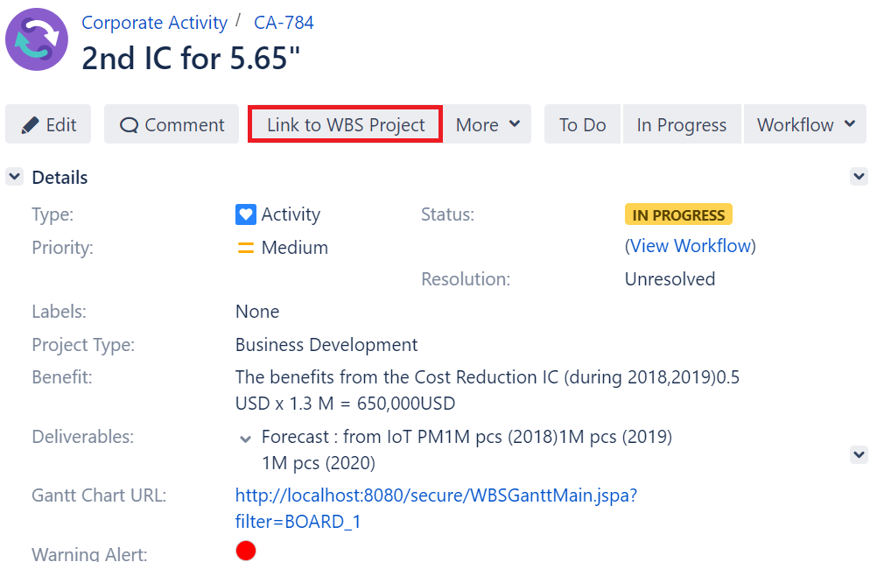
Between Projects Link
子母專案的結構化視覺操作

Slide 13
WBS Gantt Chart

Slide 14
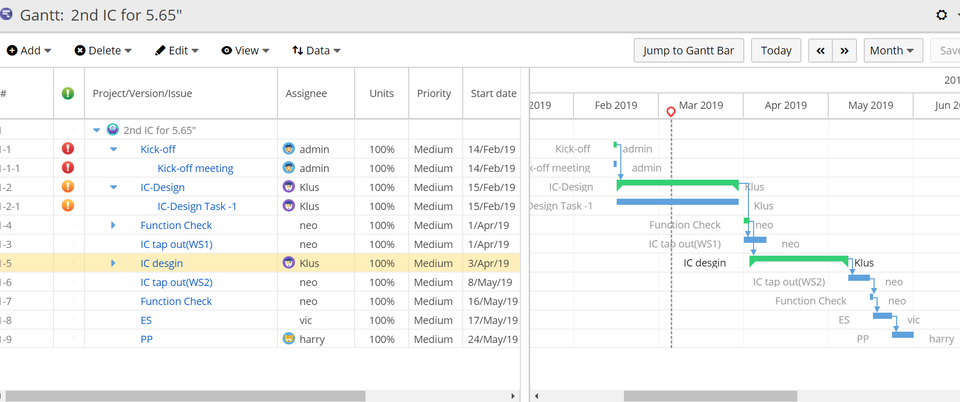
WBS Gantt Chart
透過WBS Gantt Chart追蹤專案任務進程

Slide 15
WBS Critical Path

Slide 16
Q&A

