Slide 1
Power report on your JIRA
Neo • Linksoft Inc • @ Linksoft Seminar 2016

Slide 2
Outline
Warm up
The concept of eazyBI
How eazyBI work on JIRA
Q & A

Slide 3
What is BI?

Slide 4
What’s BI?
商業智慧(Business intelligence)是指運用資料庫技術、線上分析(Online Analytical Processing, OLAP)、資料探勘Data Mining與數位圖表等技術來進行數據的分析，以呈現企業的營運狀況。
Helps you find the answers to the questions you know

Slide 5
The right decision to make

Slide 6
The structure of easyBI

Slide 7
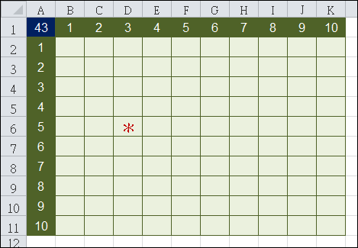
The structure of eazyBI

Slide 8
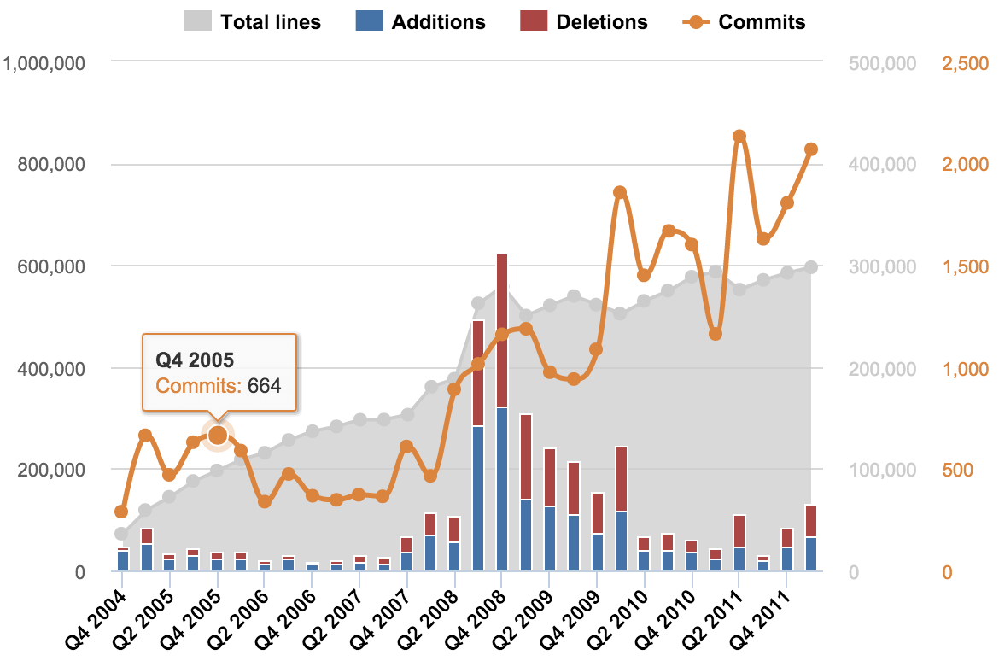
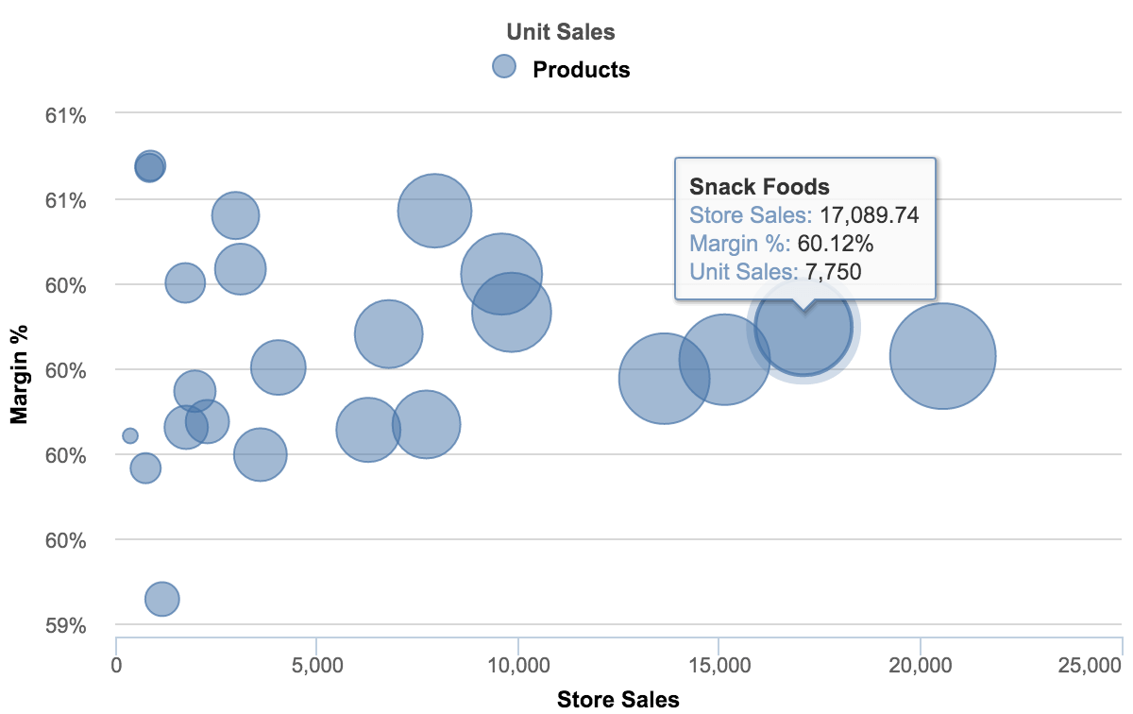
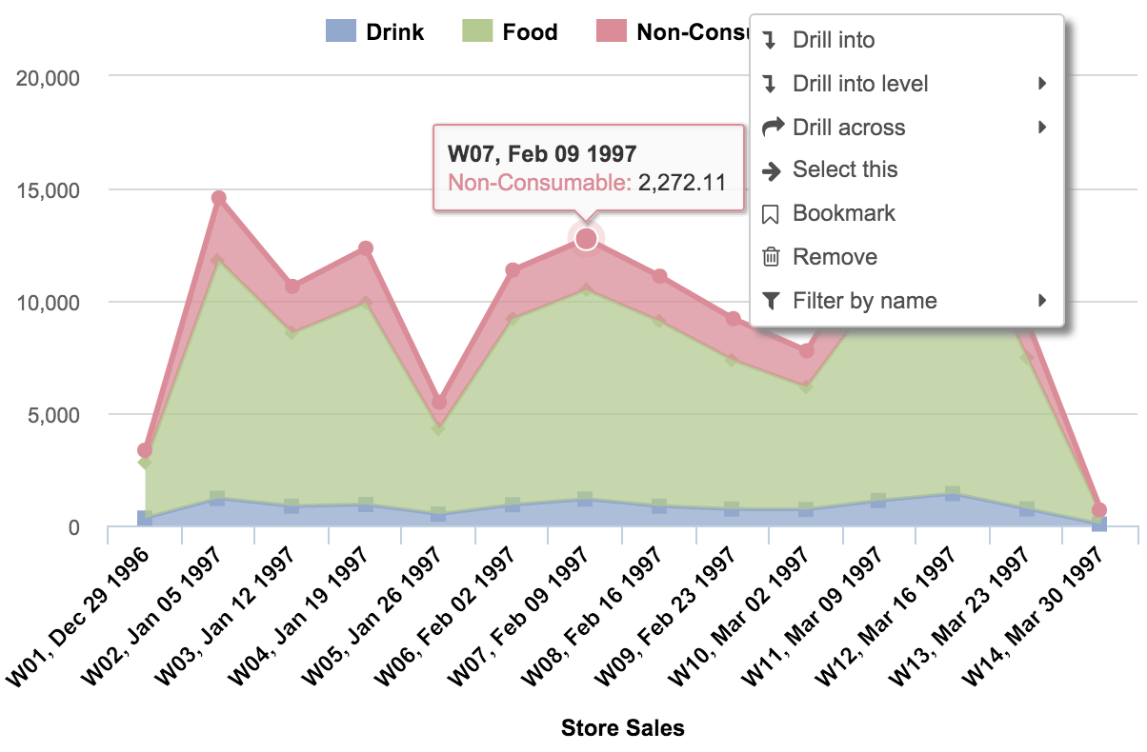
The flexibility of making your chart

Slide 9
Let’s take a peek at eazyBI

Slide 10
The change of the interface

Slide 11
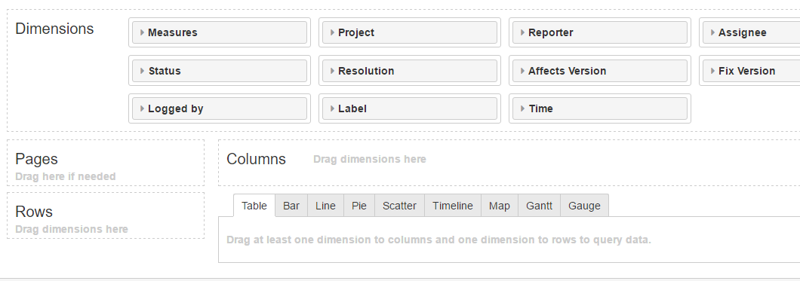
Making your own chart

Slide 12
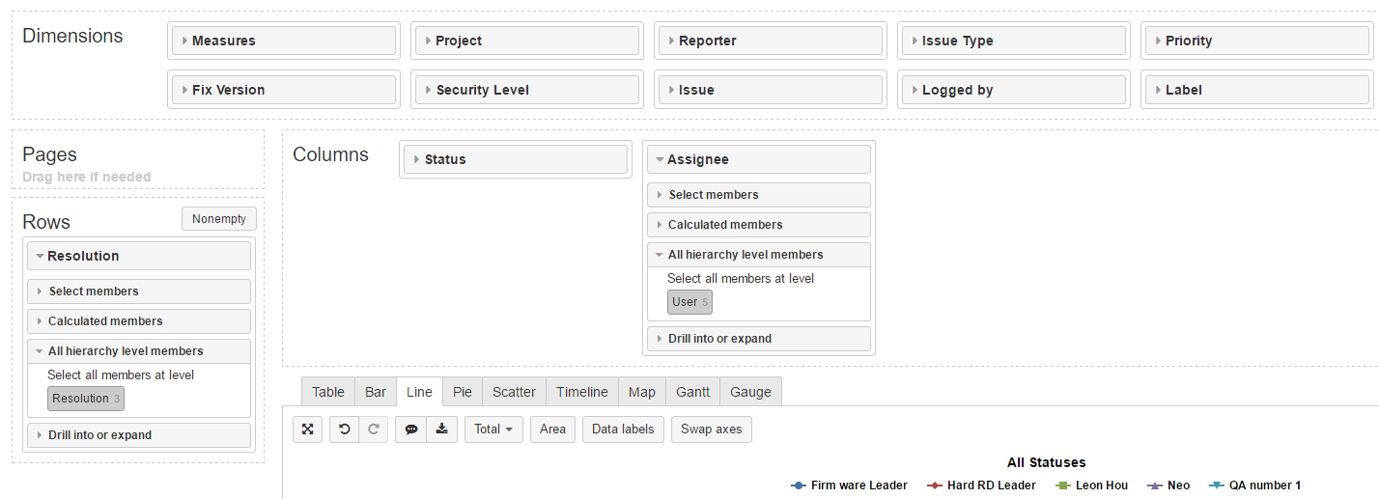
Simple Drag-and-Drop

Slide 13
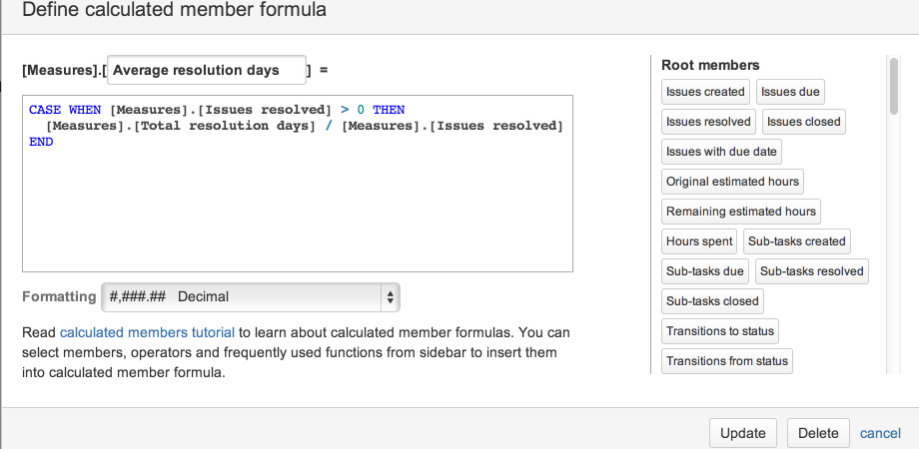
Powerful Calculations for users

Slide 14
Having your own dashboard

Slide 15
Tired of switching interface?

Slide 16
Let’s try the eazyBI gadget on JIRA

Slide 17
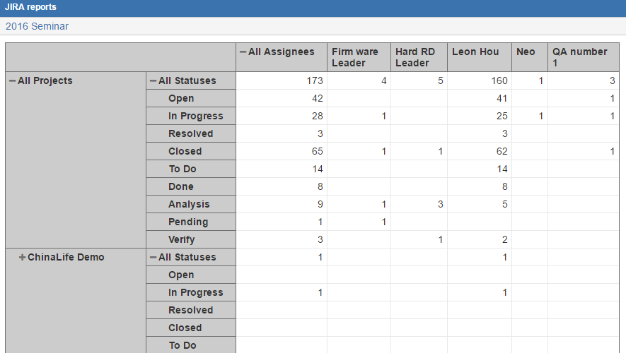
Get your eazyBI report on JIRA

Slide 18
Q&A

Slide 19
Thank you for listening

