Slide 1

Bamboo Live DEMO
Continuous delivery, from code to deployment
Leon Hou • Linksoft Inc • @ Live DEMO 2015

Slide 2
Who use the JIRA?
JIRA Advantage
JIRA Live DEMO
Atlassain Solution Overview
Agile Section & Project Management
Service Desk Section
Confluence Section
Bamboo Section
JIRA with QA Job by Spiratest
Technical support & training
Q&A

Slide 3























Who use the JIRA
Over 50,000 companies have purchased our enterprise software
For more case : https://www.atlassian.com/company/customers/customer-list

Slide 4
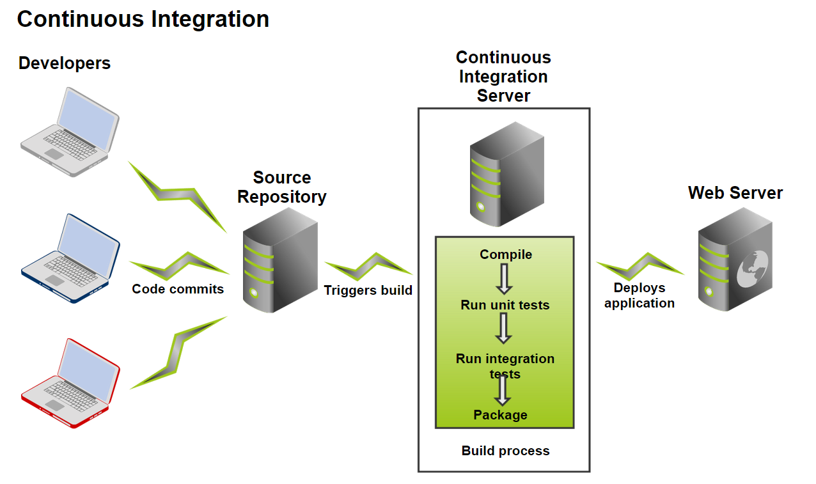
What’s Bamboo
CI(Continuous integration)沒有自動化編譯與測試能力等於白談.
依據您制定的Plan,平行化的自動執行

Slide 5


Bamboo Overview
Developer
Issue
Build & Test Result
CI Server
平行編譯與測試
Build Script
Test Suites
Commit
Triggers
By Schedule
By commit detected
By Repository branch

Slide 6
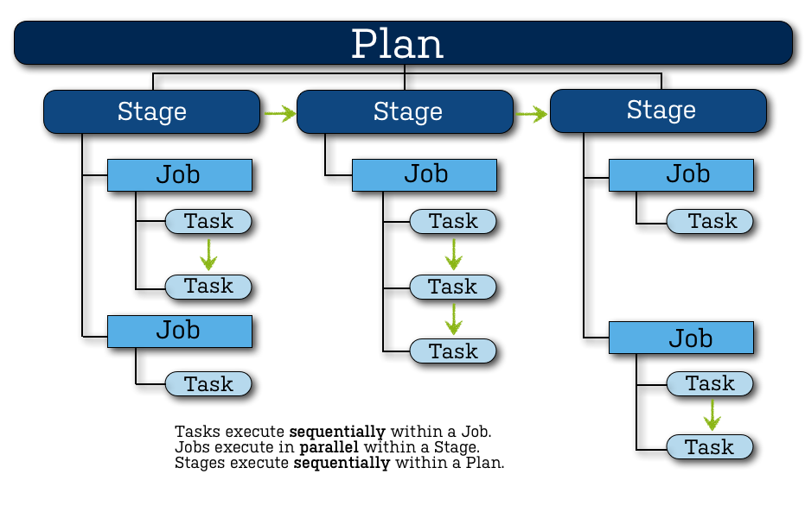
Parallel Compile & Run Test

Slide 7
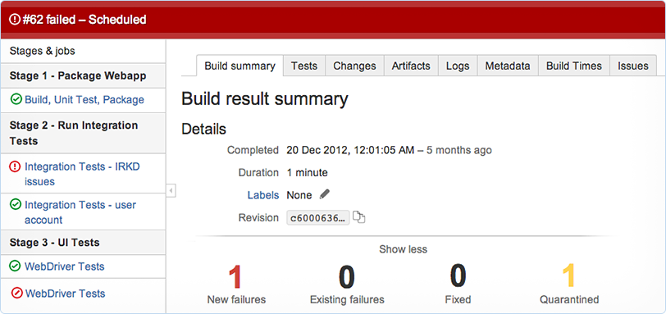
Get fast feedback

Slide 8
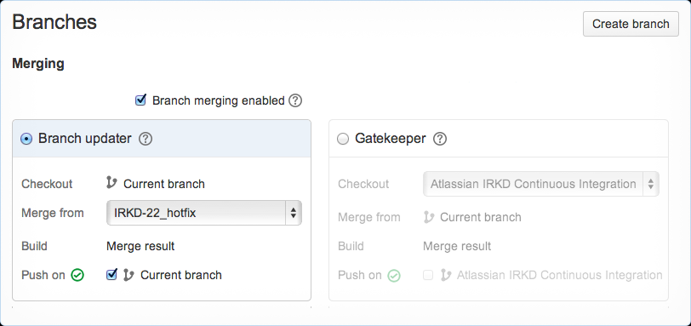
Painless CI on dev branches

Slide 9
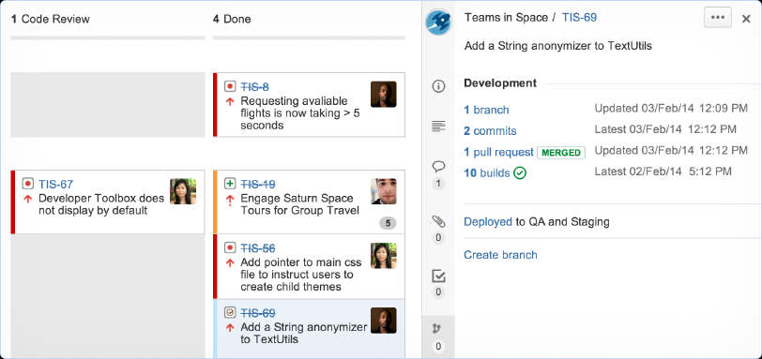
Plan, track, build, deliver

Slide 10
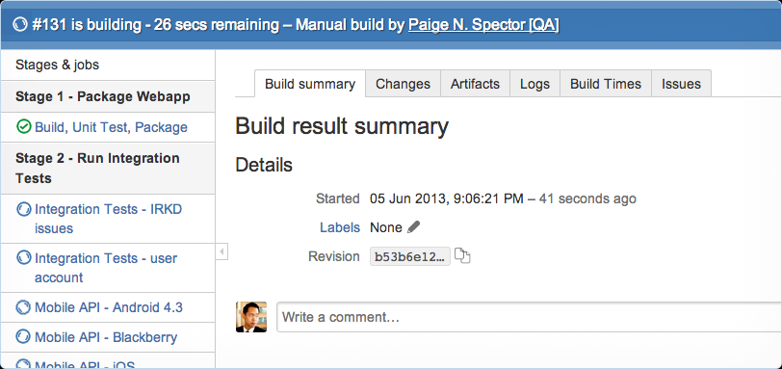
Run tests in parallel

Slide 11







Q&A

